Slide 1
BJTs-DC Biasing

Slide 2
Introduction
The transistor is a magical device that can raise the level of the applied ac input without the assistance of an external energy source.
In actuality, the improved output ac power level is the result of a transfer of energy from the applied dc supplies.
The analysis or design of any electronic amplifier therefore has two components: the dc portion and the ac portion.

Slide 3
Biasing
Biasing:
External dc voltages are applied to ensure that transistor can operate in the desired regions for desired applications is called biasing.
For amplifier application, transistor should operate in active region
For switch application, it should operate in cut-off and saturation.

Slide 4
Biasing
Why do we need biasing?
One fundamental function of transistor is amplification. For faithful amplification, the transistor needs to be operated in active mode:
Emitter-Base junction forward biased
Collector-Base junction reverse biased
To operate in the desired mode
To stabilize the operating point (Q-point) against the changes in temperature, variations in transistor parameters, aging of the components etc.

Slide 5
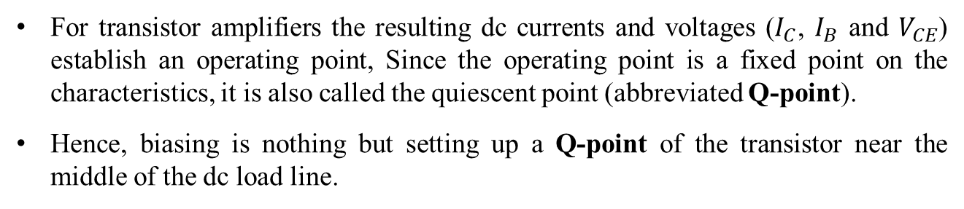
Operating Point
For transistor amplifiers the resulting dc currents and voltages ($I_{C}$, $I_{B}$ and $V_{CE}$) establish an operating point, Since the operating point is a fixed point on the characteristics, it is also called the quiescent point (abbreviated Q-point).
Hence, biasing is nothing but setting up a Q-point of the transistor near the middle of the dc load line.
The Q-Point the combination of I_{C} and V_{CE} on the dc load line where a transistor has no input signal (Quiescent – at rest)

Slide 6
Operating Point
If no bias were used, the device would initially be completely off, resulting in a Q-point at A. Since it is necessary to bias a device so that it can respond to the entire range of an input signal, point A would not be suitable.
For point B, if a signal is applied to the
circuit, the device will vary in current and voltage from operating point, but not enough to drive the device into cutoff or saturation.
Point C would allow some positive and negative variation of the output signal, but the peak-to-peak value would be limited by the proximity of V_{CE}=0
Point D sets the device operating point near the maximum voltage and power level. The output voltage swing in the positive direction is thus limited if the maximum voltage is not to be exceeded.
Point B therefore seems the best operating point in terms of linear gain and largest possible voltage and current swing.

Slide 7
The Three States of Operation
Active or Linear Region Operation
Base–Emitter junction is forward biased
Base–Collector junction is reverse biased
Cutoff Region Operation
Base–Emitter junction is reverse biased
Saturation Region Operation
Base–Emitter junction is forward biased
Base–Collector junction is forward biased

Slide 8
DC Biasing Circuits
Fixed-bias circuit or Base-bias
Emitter-stabilized bias circuit
Voltage divider bias circuit
DC bias with voltage feedback

Slide 9
Fixed Biasing Circuit
For Fixed Bias Configuration:
Draw Equivalent Input circuit
Draw Equivalent Output circuit
Write necessary KVL and KCL Equations
Determine the Quiescent Operating Point
Graphical Solution using Load lines
Computational Analysis
Design and test design using a computer simulation

Slide 10
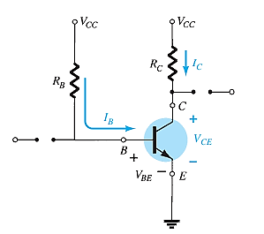
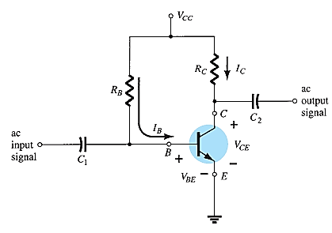
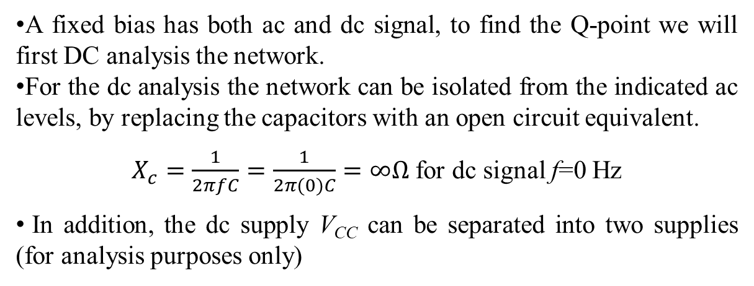
Fixed Bias Circuit
A fixed bias has both ac and dc signal, to find the Q-point we will first DC analysis the network.
For the dc analysis the network can be isolated from the indicated ac levels, by replacing the capacitors with an open circuit equivalent.
$X_{c}=\frac{1}{2πfC}=\frac{1}{2π(0)C}=∞Ω$ for dc signal f=0 Hz
In addition, the dc supply V_{CC} can be separated into two supplies (for analysis purposes only)

Slide 11
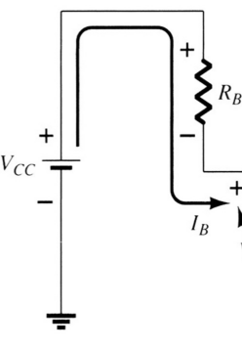
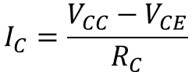
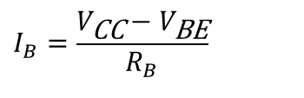
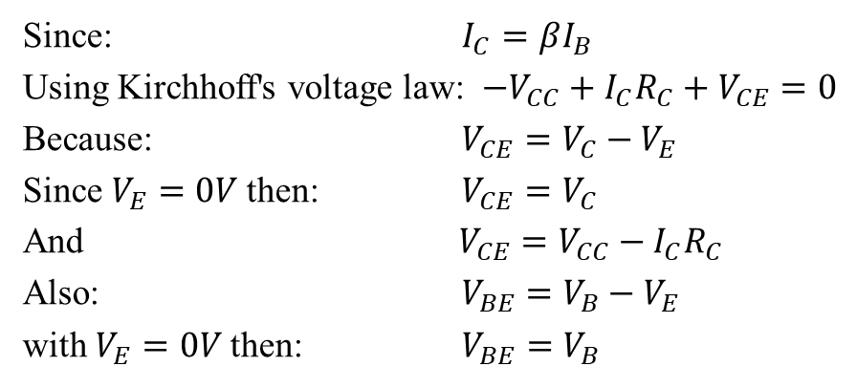
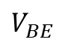
Fixed Bias Circuit
The Base-Emitter Loop:
From Kirchhoff’s voltage law:
+V_{CC} – I_{B}R_{B} – V_{BE} = 0
Solving for base current:
$$I_{B}=\frac{V_{\text{CC}}−V_{\text{BE}}}{R_{B}}$$
$$V_{BE}$$
Collector-Emitter Loop:
Since: $I_{C}=βI_{B}$
Using Kirchhoff's voltage law: $−V_{CC}+I_{C}R_{C}+V_{CE}=0$
Because: $V_{CE}=V_{C}−V_{E}$
Since $V_{E}=0V$then: $V_{CE}=V_{C}$
And $V_{CE}=V_{CC}−I_{C}R_{C}$
Also: $V_{BE}=V_{B}−V_{E}$
with $V_{E}=0V$then: $V_{BE}=V_{B}$
$$I_{C}=\frac{V_{CC}−V_{CE}}{R_{C}}$$
As V_{CC} is of fixed value, on selection of R_{B}, the base current I_{B} is fixed. Therefore this type is called fixed bias type of circuit.

Slide 12
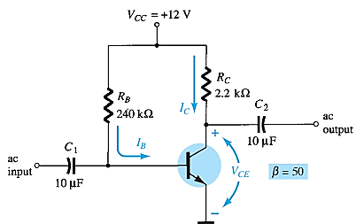
Fixed Bias Circuit
Determine the following for the fixed-bias configuration.
a. I_{BQ} and I_{CQ}.
b. V_{CEQ}.
c. V_{B} and V_{C} .
d. V_{BC} .

Slide 13
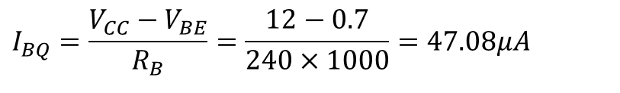
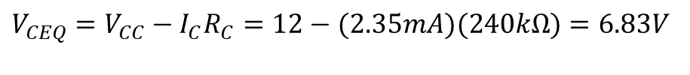
Fixed Bias Circuit
Determine the following for the fixed-bias configuration.
a. I_{BQ} and I_{CQ}.
b. V_{CEQ}.
c. V_{B} and V_{C} .
d. V_{BC} .
$$I_{BQ}=\frac{V_{CC}−V_{BE}}{R_{B}}=\frac{12−0.7}{240×1000}=47.08μA$$
$$I_{CQ}=β_{dc}I_{BQ}=50×47.08×10^{−6}=2.35mA$$
$$V_{CEQ}=V_{CC}−I_{C}R_{C}=12−(2.35mA)(240kΩ)=6.83V$$
$$V_{BC}=V_{B}−V_{C}=0.7−6.83=−6.13V$$
The negative sign reveals that the junction is reversed-biased, as it should be for linear amplification.

Slide 14
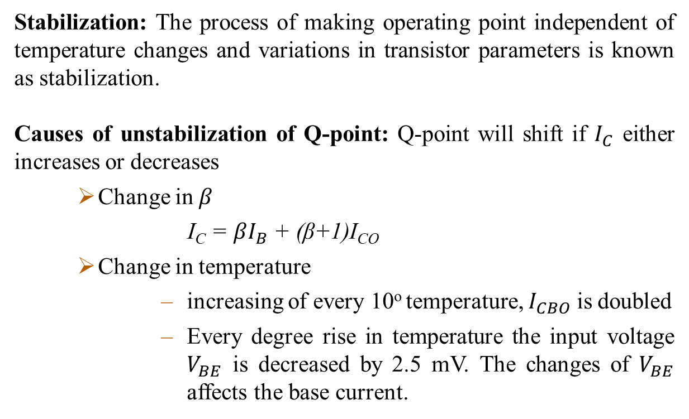
Stabilization
Stabilization: The process of making operating point independent of temperature changes and variations in transistor parameters is known as stabilization.
Causes of unstabilization of Q-point: Q-point will shift if $I_{C}$ either increases or decreases
Change in $β$
I_{C} = $βI_{B}$ + (β+1)I_{CO}
Change in temperature
increasing of every 10º temperature, $I_{CBO}$ is doubled
Every degree rise in temperature the input voltage $V_{BE}$ is decreased by 2.5 mV. The changes of $V_{BE}$ affects the base current.

Slide 15
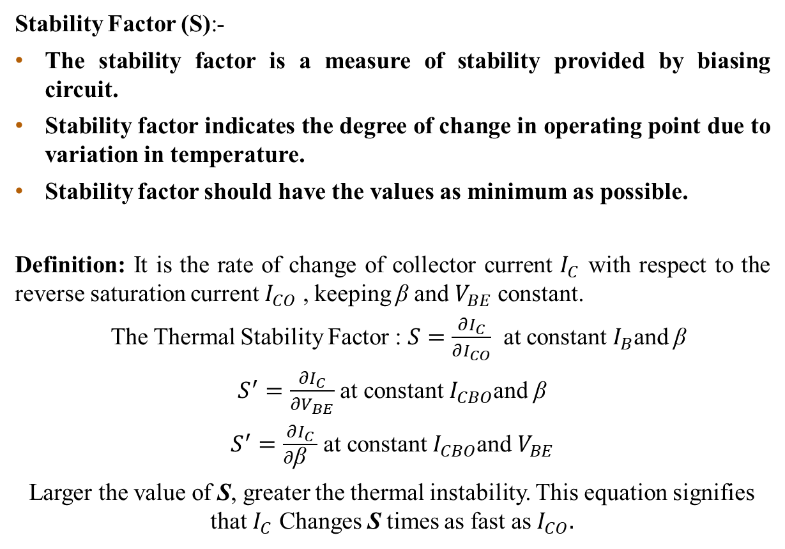
The Thermal Stability of Operating Point (S)
Stability Factor (S):-
The stability factor is a measure of stability provided by biasing circuit.
Stability factor indicates the degree of change in operating point due to variation in temperature.
Stability factor should have the values as minimum as possible.
Definition: It is the rate of change of collector current $I_{C}$ with respect to the reverse saturation current $I_{CO}$ , keeping β and $V_{BE}$ constant.
The Thermal Stability Factor : $S=\frac{∂I_{C}}{∂I_{CO}}$ at constant $I_{B}$and β
$S^{′}=\frac{∂I_{C}}{∂V_{BE}}$ at constant $I_{CBO}$and β
$S^{′}=\frac{∂I_{C}}{∂\text{β} }$ at constant $I_{CBO}$and $V_{BE}$
Larger the value of S, greater the thermal instability. This equation signifies that $I_{C}$ Changes S times as fast as $I_{CO}.$

Slide 16
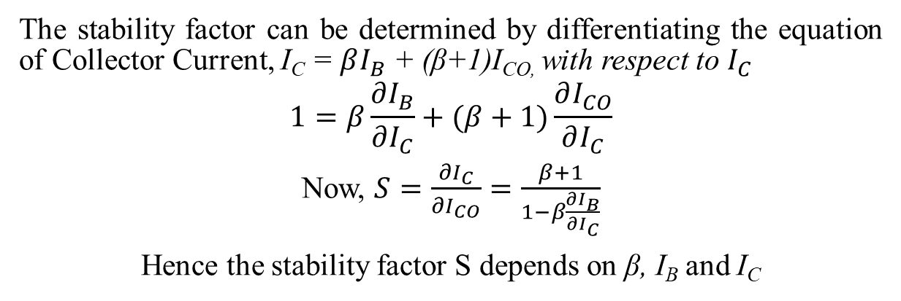
The Thermal Stability of Operating Point (S)
The stability factor can be determined by differentiating the equation of Collector Current, I_{C} = $βI_{B}$ + (β+1)I_{CO,} with respect to $I_{C}$
$$1=β\frac{∂I_{B}}{∂I_{C}}+(β+1)\frac{∂I_{CO}}{∂I_{C}}$$
Now, $S=\frac{∂I_{C}}{∂I_{CO}}=\frac{β+1}{1−β\frac{∂I_{B}}{∂I_{C}}}$
Hence the stability factor S depends on β, I_{B} and I_{C}

Slide 17
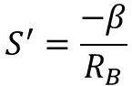
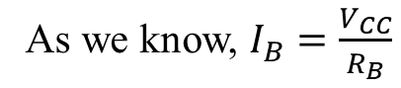
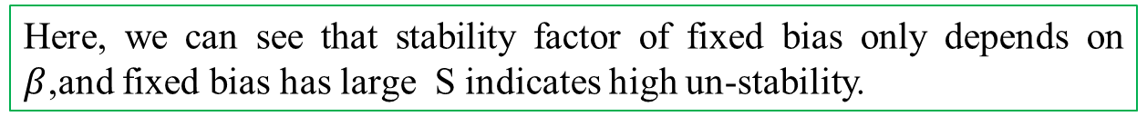
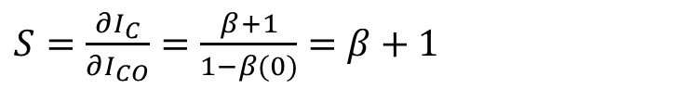
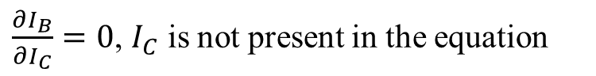
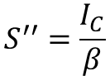
Stability Factor of Fixed Bias
Stability Factor (S), $S=\frac{∂I_{C}}{∂I_{CO}}=\frac{β+1}{1−β\frac{∂I_{B}}{∂I_{C}}}$
As we know, $I_{B}=\frac{V_{CC}}{R_{B}}$
When $I_{B}$ changes by $∂I_{B}$, $V_{CC}$and $V_{BE}$ are unaffected
$\frac{∂I_{B}}{∂I_{C}}=0$, $I_{C}$ is not present in the equation
$S=\frac{∂I_{C}}{∂I_{CO}}=\frac{β+1}{1−β(0)}=$ $β+1$
Here, we can see that stability factor of fixed bias only depends on $β$,and fixed bias has large S indicates high un-stability.
$$S^{′}=\frac{−β}{R_{B}}$$
$$S^{′′}=\frac{I_{C}}{β}$$

Slide 18
Fixed Bias Circuit
Pros and Cons of Fixed bias:
Pros:
Simple circuit
Uses very few resistors
Cons: Q-point is unstable
If temperature increases, then β increases, and hence I_{CQ} and V_{CEQ} vary (effectively Q-point shifts)
If the transistor is replaced with another transistor having different β value, then also Q-point shifts
Usage:
Due to the above inherent drawbacks, fixed bias is rarely used in linear circuits.
Instead, it is often used in circuits where transistor is used as a switch.

Slide 19
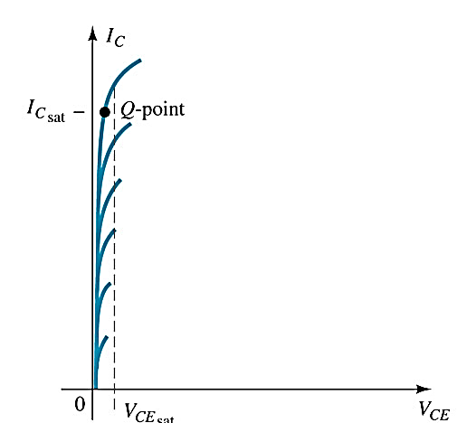
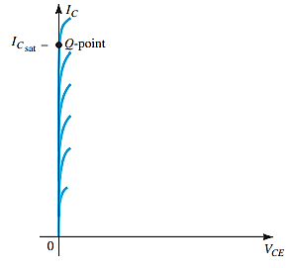
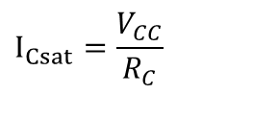
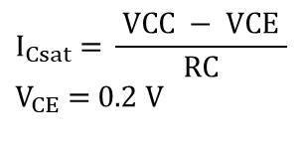
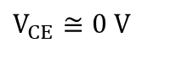
Saturation
When the transistor is operating in saturation, current through the transistor is at its maximum possible value.
$$I_{Csat}\text{ = }\frac{ \text{VCC}\text{ − }\text{VCE} }{RC} \\ V_{CE}\text{ = 0.2 }\text{V}$$
$$I_{Csat}=\frac{V_{CC}}{R_{C}}$$
$$V_{CE}≅0 V$$

Slide 20
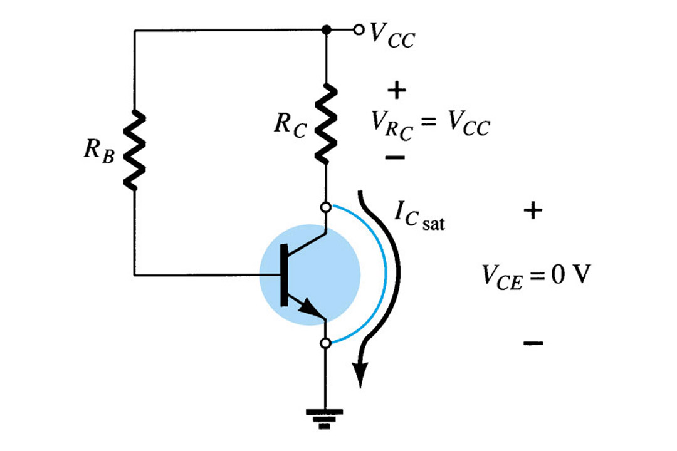
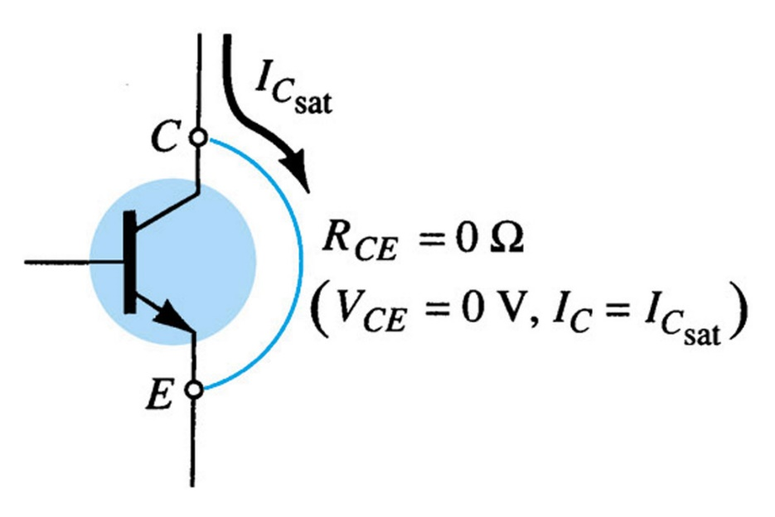
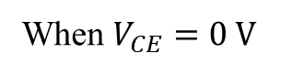
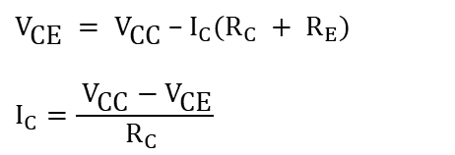
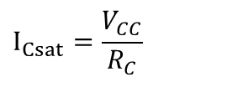
Determining ICsat
$$V_{\text{CE}} = {\text{V}}_{\text{CC}}\text{ – }{\text{I}}_{C}(R_{C} + {\text{R}}_{E})$$
$${\text{I}}_{C}=\frac{ {\text{V}}_{\text{CC}}−V_{\text{CE}}}{R_{C} }$$
Determining I_{Csat} for the fixed-bias configuration.
When $V_{CE}=\text{0 }\text{V}$
$$I_{Csat}=\frac{V_{CC}}{R_{C}}$$

Slide 21
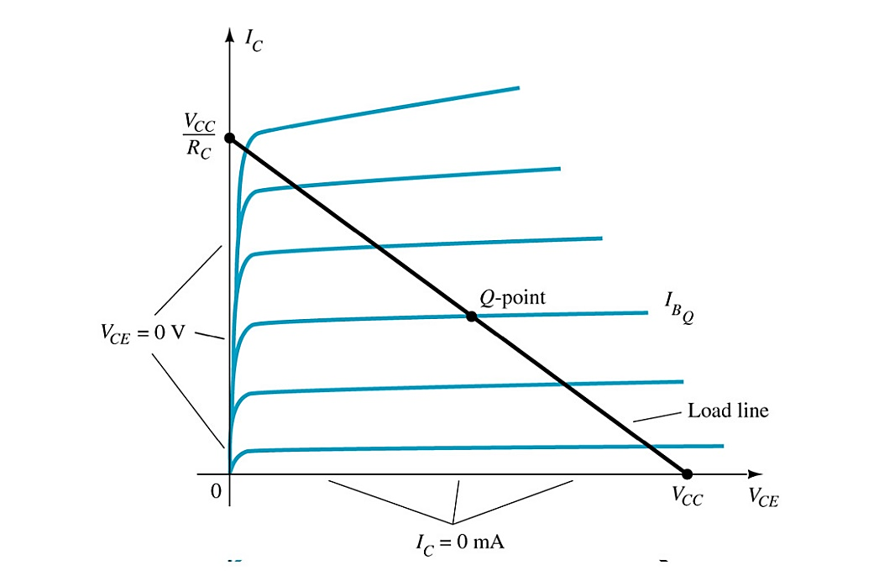
Load Line Analysis
The end points of the load line are:
I_{Csat}
I_{C} = V_{CC} / R_{C}
V_{CE} = 0 V
V_{CEcutoff}
V_{CE} = V_{CC}
I_{C} = 0 mA
This line called the load line, since it is defined by the load resistance Rc
Where IB intersects with the load line we have the Q-point
Q-point is the particular operating point:
Value of R_{B}
Sets the value of I_{B}
Where I_{B} and Load Line intersect
Sets the values of V_{CE} and I_{C}.

Slide 22
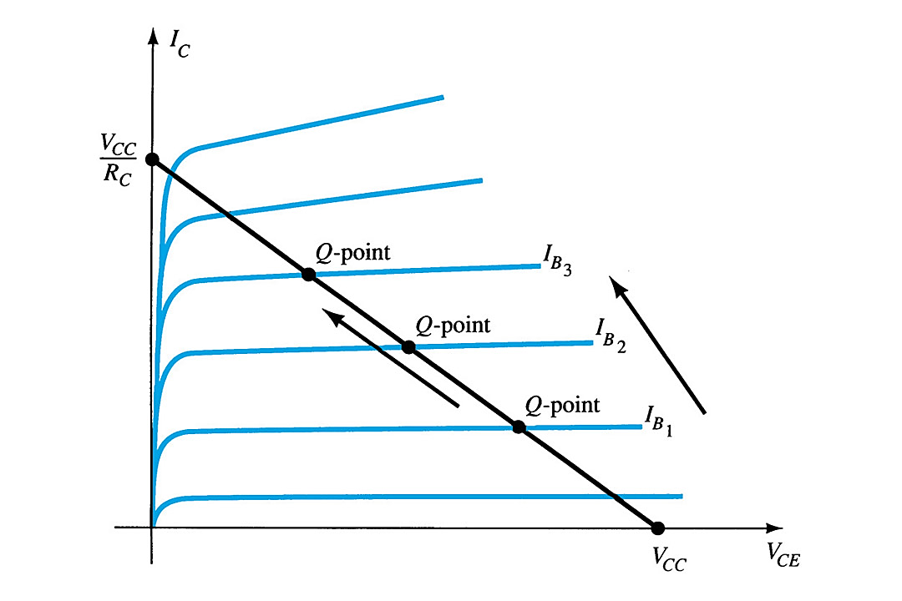
Circuit Values Affect the Q-Point
If the level of IB is changed by varying the value of RB the Q-point moves up or
down the load line

Slide 23
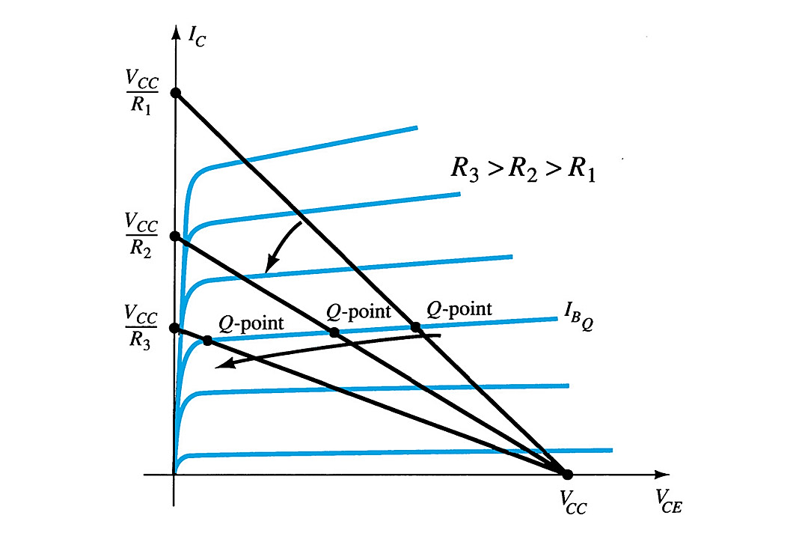
Circuit Values Affect the Q-Point
Effect of increasing levels of R_{C} on the load line and Q-point.

Slide 24
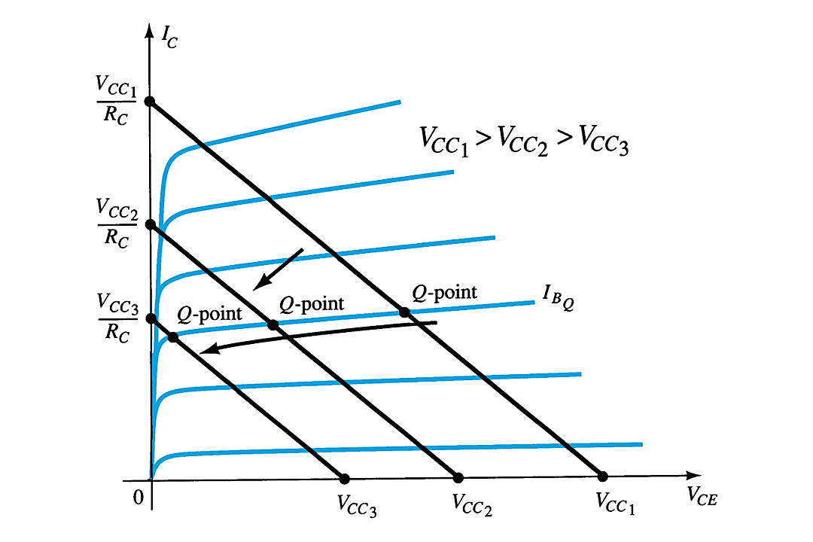
Circuit Values Affect the Q-Point
Effect of lower values of V_{CC} on the load line and Q-point.

Slide 25
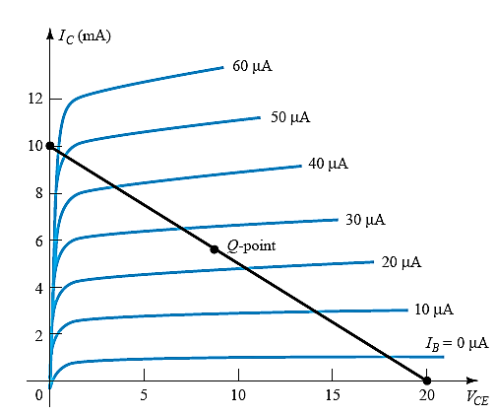
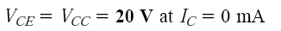
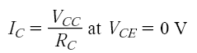
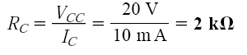
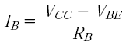
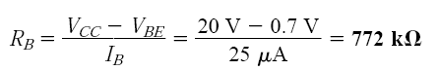

Slide 26
Emitter-Stabilized Bias Circuit
For the Emitter Stabilized Bias Configuration:
Draw Equivalent Input circuit
Draw Equivalent Output circuit
Write necessary KVL and KCL Equations
Determine the Quiescent Operating Point
Graphical Solution using Load lines
Computational Analysis
Design and test design using a computer simulation

Slide 27
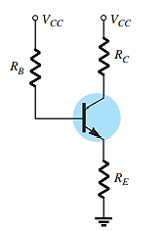
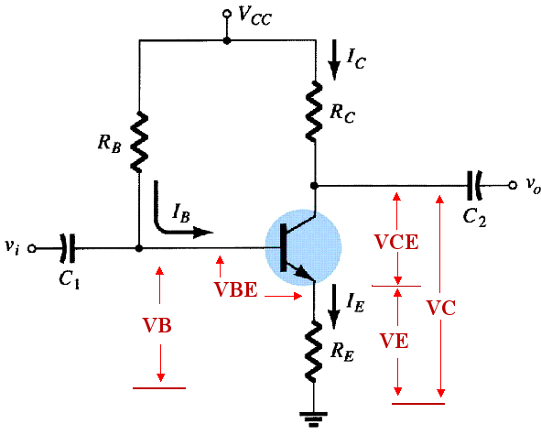
Emitter-Stabilized Bias Circuit
Adding a resistor (R_{E}) to the emitter circuit stabilizes the bias circuit over fixed bias
BJT bias circuit with emitter resistor
DC equivalent circuit

Slide 28
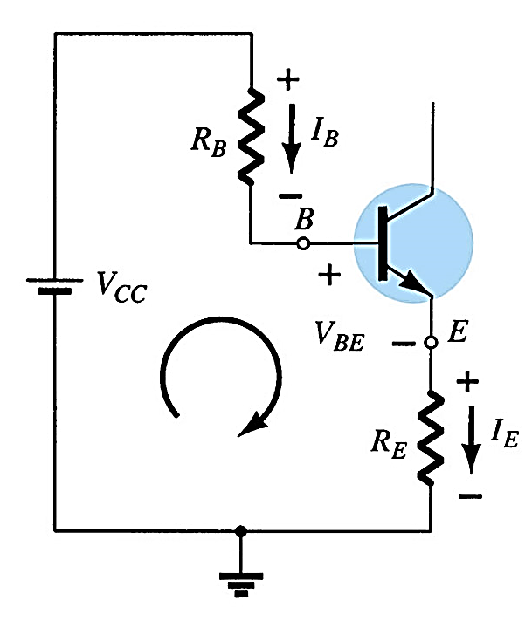
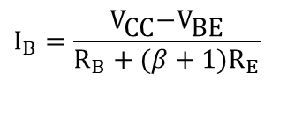
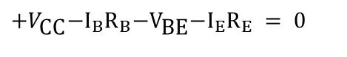
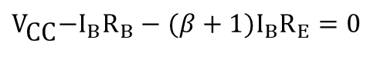
Base-Emitter Loop
From Kirchhoff’s voltage law:
$$+V_{\text{CC}}\text{−}{\text{I}}_{B}R_{B}\text{−}{\text{V}}_{\text{BE}}\text{−}{\text{I}}_{E}R_{E} =\text{ 0}$$
Since I_{E} = (β + 1)I_{B}:
$$V_{\text{CC}}\text{−}{\text{I}}_{B}R_{B}−(β+1)I_{B}R_{E}=0$$
Solving for I_{B}:
$$I_{B}=\frac{V_{\text{CC}}\text{−}{\text{V}}_{\text{BE}}}{R_{B}+(β+1)R_{E}}$$

Slide 29
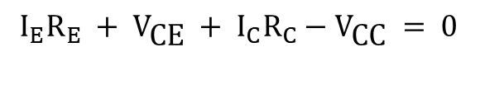
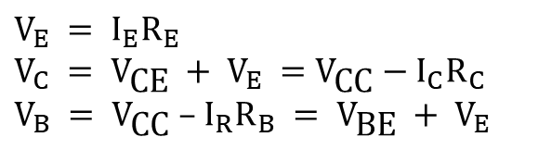
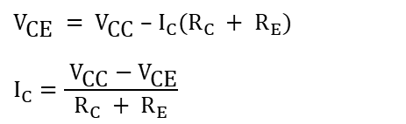
Collector-Emitter Loop
From Kirchhoff’s voltage law:
$${\text{I}}_{E}R_{E} + {\text{V}}_{\text{CE}} + {\text{I}}_{C}R_{C}−V_{\text{CC}} =\text{ 0}$$
Since I_{E} ≅ I_{C}:
$$V_{\text{CE}} = {\text{V}}_{\text{CC}}\text{ – }{\text{I}}_{C}(R_{C} + {\text{R}}_{E})$$
$${\text{I}}_{C}=\frac{ {\text{V}}_{\text{CC}}−V_{\text{CE}}}{R_{C} + {\text{R}}_{E}}$$
Also:
$$V_{E} = {\text{I}}_{E}R_{E} \\ V_{C} = {\text{V}}_{\text{CE}} + {\text{V}}_{E} =V_{\text{CC}}\text{ − }{\text{I}}_{C}R_{C} \\ V_{B} = {\text{V}}_{\text{CC}}\text{ – }{\text{I}}_{R}R_{B} = {\text{V}}_{\text{BE}} + {\text{V}}_{E}$$

Slide 30







Stability Factor for Emitter Bias Circuit
Adding RE to the emitter improves the stability of a transistor.
We know, for emitter bias circuit, $I_{B}=\frac{V_{\text{CC}}\text{−}{\text{V}}_{\text{BE}}−I_{C}R_{E}}{R_{B}+R_{E}}$
$$S=\frac{∂I_{C}}{∂I_{CO}}=\frac{β+1}{1−β\frac{∂I_{B}}{∂I_{C}}}$$
If we differentiate the first equation with respect to $I_{C}$ we get
$$\frac{∂I_{B}}{∂I_{C}}=\frac{−R_{E}}{R_{B}+R_{E}}$$
Substitute the value of $\frac{∂I_{B}}{∂I_{C}}$ in the second equation.
$$S=\frac{(β+1)(R_{B}+R_{E})}{R_{B}+(β+1)R_{E}}$$
$$S=\frac{1+R_{B}/R_{E}}{1+R_{B}/(β+1)R_{E}}$$
If we consider $R_{B}≪R_{E}$, $S=1$
This circuit achieves good stability of dc operating point against changes in β with the help of emitter resistor which causes degeneration to take place.

Slide 31
Emitter-Stabilized Bias Circuit
Pros and Cons of Emitter Stabilized Circuit:
Pros:
The circuit has the tendency to stabilize operating point against changes in temperature and β-value.
Cons:
As β-value is fixed for a given transistor, this relation can be satisfied either by keeping R_{E} very large, or making R_{B} very low.
If R_{E} is of large value, high V_{CC} is necessary. This increases cost as well as necessary precautions while handling. a switch.

Slide 32






Slide 33





Slide 34


Saturation Level
The endpoints can be determined from the load line.
V_{CEcutoff}:
I_{Csat}:
$${\text{I}}_{C}=\frac{ {\text{V}}_{\text{CC}}−V_{\text{CE}}}{R_{C} + {\text{R}}_{E}}$$
$$V_{CE}=\text{0 }\text{V} \\ I_{Csat}=\frac{V_{CC}}{R_{C}+R_{E}}$$

Slide 35




Load line Analysis for Emitter Stabilized Bias Circuit
The collector-emitter loop equation that defines the load line is:
$$V_{CE}=V_{CC}−I_{C}\left(R_{C}+R_{E}\right)$$
Choosing I_{C} = 0 gives
$$V_{CE}=V_{CC}$$
And choosing V_{CE} = 0 gives
$$I_{C}=\frac{V_{CC}}{R_{C}+R_{E}}$$

Slide 36

Load line Analysis for Emitter Stabilized Bias Circuit
Problem:
Draw the load line for the network of Fig. (a) on the characteristics for the transistor appearing in Fig. (b).
For a Q -point at the intersection of the load line with a base current of 15 m A , find the values of I_{CQ} and V_{CEQ}.
Determine the dc beta at the Q-point.
Using the beta for the network determined in part c, calculate the required value of R_{B} and suggest a possible standard value.

Slide 37




Solution:
(a) Two points on the characteristics are required to draw the load line.
(b) From the characteristics curve,
we find
(c) The resulting dc beta is:
(d)

Slide 38


Voltage Divider Bias
This is a very stable bias circuit.
The currents and voltages are nearly independent of any variations in β, since it is temperature sensitive especially for silicon transistors
1st step: Locate capacitors and replace them with an open circuit

Slide 39




Voltage Divider Bias
2nd step: Simplify the circuit using Thevenin Theorem
From Thevenin’s Theorem
$$R_{TH}=R_{1}//R_{2}=\frac{R_{1}×R_{2}}{R_{1}+R_{2}}$$
$$V_{TH}=\frac{R_{2}}{R_{1}+R_{2}}V_{CC}$$

Slide 40



Voltage Divider Bias
3rd step: Locate 2 main loops.
BE Loop
CE Loop
2
2
1
1

Slide 41



Voltage Divider Bias
BE Loop Analysis:
From KVL:
$$V_{TH}−I_{B}R_{TH}−V_{BE}−I_{E}R_{E}=0$$
$$V_{TH}−I_{B}R_{TH}−V_{BE}−{(I_{C}+I_{B})R}_{E}=0$$
But
1
$$I_{E}=(β+1)I_{B}$$
$$V_{TH}−I_{B}R_{TH}−V_{BE}−(β+1)I_{B}R_{E}=0 \\ ∴I_{B}=\frac{V_{TH}−V_{BE}}{R_{RTH}+(β+1)R_{E}}$$

Slide 42




Voltage Divider Bias
From KVL:
$$V_{CC}−I_{C}R_{C}−V_{CE}−I_{E}R_{E}=0$$
Assume
I_{C} ≈ I_{E}
2
$$∴V_{CC}−I_{C}R_{C}−V_{CE}−I_{C}R_{E}=0$$
$$V_{CE}=V_{CC}−I_{C}(R_{C}+R_{E})$$

Slide 43

DC load line with Voltage Divider Bias
The dc load line can be drawn from the following equation:
$$V_{CE}=V_{CC}−I_{C}(R_{C}+R_{E})$$
I_{C}
V_{CE}
V_{CC}

Slide 44




Example: Determine the exact and the approximate dc bias voltage V_{CE} and the current I_{C} for the following voltage-divider configuration:
$$R_{TH}=\frac{R_{1}R_{2}}{R_{1}+R_{2}}=\frac{39k×3.9k}{39k+3.9K}=3.55KΩ$$
$$V_{TH}=\frac{R_{2}V_{CC}}{R_{1}+R_{2}}=\frac{3.9kΩ×22}{39kΩ+3.9kΩ}=2V$$
$$I_{B}=\frac{V_{TH}−V_{BE}}{R_{TH}+\left(β+1\right)R_{E}}=6.05μA$$
$$I_{C}=β_{dc}I_{B}=140×6.05μA=0.85mA$$
$$V_{CE}=V_{CC}−I_{C}\left(R_{C}+R_{E}\right)=12.22V$$

Slide 45






Stability Factor for Voltage Divider Bias
Provides good Q-point stability with a single polarity supply voltage
We know, for voltage divider bias circuit, $V_{TH}−I_{B}R_{TH}−V_{BE}−{(I_{C}+I_{B})R}_{E}=0$
$$I_{B}=\frac{V_{\text{TH}}\text{−}{\text{V}}_{\text{BE}}−I_{C}R_{E}}{R_{TH}+R_{E}}$$
$$S=\frac{∂I_{C}}{∂I_{CO}}=\frac{β+1}{1−β\frac{∂I_{B}}{∂I_{C}}}$$
If we differentiate the current $I_{B}$ with respect to $I_{C}$ we get
$$\frac{∂I_{B}}{∂I_{C}}=\frac{−R_{E}}{R_{TH}+R_{E}}$$
Substitute the value of $\frac{∂I_{B}}{∂I_{C}}$ in the second equation.
$$S=\frac{(β+1)(R_{TH}+R_{E})}{R_{TH}+(β+1)R_{E}}$$
$$S=\frac{1+R_{TH}/R_{E}}{1+R_{TH}/(β+1)R_{E}}$$
If we consider $R_{TH}≪R_{E}$, $S=1$
Here we can see that stability factor independent of β. So, the operating point remains where it is fixed.

Slide 46

Voltage Divider Bias Circuit
Pros and Cons of Emitter Stabilized Circuit:
Pros:
Operating point is almost independent of β variation.
Operating point stabilized against shift in temperature..
Cons:
As β-value is fixed for a given transistor, this relation can be satisfied either by keeping R_{E} fairly large
If $R_{B}$ is Small, circuit will draw more current from $V_{cc}$, which reduce the battery life.
If R_{E} is of large value, high V_{CC} is necessary.
This increases cost as well as precautions necessary while handling.
Usage:
Widely used in linear circuits .

Slide 47
Voltage Divider Bias Analysis
Transistor Saturation Level
Load Line Analysis
Cutoff: Saturation:

Slide 48

Collector Feedback Configuration
Another way to improve the stability of a bias circuit is to add a feedback path from collector to base.
In this bias circuit the Q-point is only slightly dependent on the transistor beta, β.

Slide 49



Base-Emitter Loop
From Kirchhoff’s voltage law:
$$V_{\text{CC}}\text{ – }{\text{I}}_{C}^{′}R_{C}\text{–}{\text{I}}_{B}R_{B}\text{–}{\text{V}}_{\text{BE}}\text{–}{\text{I}}_{E}R_{E}=0$$
$$V_{CC}−I_{C}R_{C}−I_{B}R_{C}−I_{B}R_{B}−V_{BE}−I_{B}R_{E}−I_{C}R_{E}=0$$
$$I_{B}=\frac{V_{CC}−V_{BE}−I_{C}(R_{C}+R_{E})}{R_{B}+R_{C}+R_{E}}$$
Where I_{B} << I_{C}:
$$\text{I}{\text{′}}_{C}=I_{C}+I_{B}≅I_{C}$$
Knowing I_{C} = βI_{B} and I_{E} ≅ I_{C}, the loop equation becomes:
$$V_{\text{CC}}\text{ – }βI_{B}R_{C}−I_{B}R_{B}−V_{BE}−βI_{B}R_{E}=0$$
Solving for I_{B}:
$$I_{B}=\frac{V_{\text{CC}}−V_{\text{BE}}}{R_{B}+β(R_{C}+R_{E})}$$

Slide 50
Collector-Emitter Loop
Applying Kirchhoff's voltage law:
I_{E} R_{E}+ V_{CE} + I’_{C}R_{C} – V_{CC} = 0
Since I′_{C} ≅ I_{C} and I_{C} = βI_{B}:
I_{C}(R_{C} + R_{E}) + V_{CE} – V_{CC} =0
Solving for V_{CE}:
V_{CE} = V_{CC} – I_{C}(R_{C} + R_{E})

Slide 51




Stability Factor for Collector Feedback Configuration
Provides good Q-point stability with a single polarity supply voltage
We know, for collector feedback configuration,
$$I_{B}=\frac{V_{CC}−V_{BE}−I_{C}(R_{C}+R_{E})}{R_{B}+R_{C}+R_{E}}$$
$$S=\frac{∂I_{C}}{∂I_{CO}}=\frac{β+1}{1−β\frac{∂I_{B}}{∂I_{C}}}$$
If we differentiate the current $I_{B}$ with respect to $I_{C}$ we get
$$\frac{∂I_{B}}{∂I_{C}}=\frac{−R_{C}+R_{E}}{R_{B}+R_{C}+R_{E}}$$
Substitute the value of $\frac{∂I_{B}}{∂I_{C}}$ in the second equation.
$$S=\frac{(β+1)(R_{B}+R_{C}+R_{E})}{R_{B}+R_{C}+R_{E}+(β){(R_{C}+R_{E})}_{}}$$
If we consider $R_{B}≪R_{E}$, $S=1$
This circuit achieves good stability of dc operating point against changes in β.

Slide 52

Collector Feedback Configuration
Pros and Cons of Emitter Stabilized Circuit:
Pros:
Operating point is almost independent of β variation.
Operating point stabilized against shift in temperature..
Cons:
As β-value is fixed for a given transistor, this relation can be satisfied either by keeping R_{E} fairly large
If $R_{B}$ is Small, circuit will draw more current from $V_{cc}$, which reduce the battery life.
If R_{E} is of large value, high V_{CC} is necessary.
This increases cost as well as precautions necessary while handling.

Slide 53
Base-Emitter Bias Analysis
Transistor Saturation Level
Load Line Analysis
Cutoff: Saturation:

Slide 54




EXAMPLE
Determine the quiescent levels of ICQ and VCEQ for the network

Slide 55



Design Operations
Given the device characteristics of Fig. a , determine V_{CC}, R_{B}, and R_{C} for the fixed-bias configuration of Fig. b

Slide 56



Design Operations
Given that I_{CQ} = 2 mA and V_{CEQ} = 10 V, determine R₁ and R_{C} for the following network.
The nearest standard commercial values to R₁ are 82 kΩ and 91 kΩ . However, using the series combination of standard values of 82 kΩ and 4.7 kΩ, 86.7 kΩ would result in a value very close to the design level.

Slide 57




Design Operations
The emitter-bias configuration of the following figure has the following specifications: I_{CQ} = 1/2Isat, I_{Csat} = 8 mA, V_{C} = 18 V, and $β=$110. Determine R_{C} , R_{E} , and R_{B}.

Slide 58

Design Operations

Slide 59

Transistor Switching Networks
Transistors with only the DC source applied can be used as electronic switches.

Slide 60

Switching Circuit Calculations
Saturation current:
To ensure saturation:
Emitter-collector resistance at saturation and cutoff:

Slide 61



Switching Circuit Calculations
Determine R_{B} and R_{C} for the transistor inverter of the following figure if I_{Csat} = 10 mA.

Slide 62
Switching Time
Transistor switching times:

Slide 63
PNP Transistors
The analysis for pnp transistor biasing circuits is the same as that for npn transistor circuits. The only difference is that the currents are flowing in the opposite direction.

